Slide 1

UML Amended

Slide 2
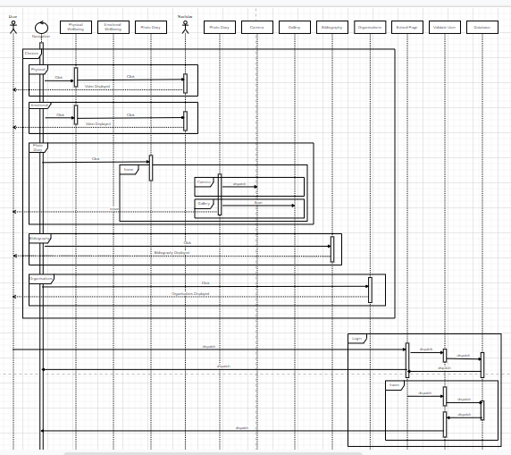
UML Sequence Amended

Slide 3
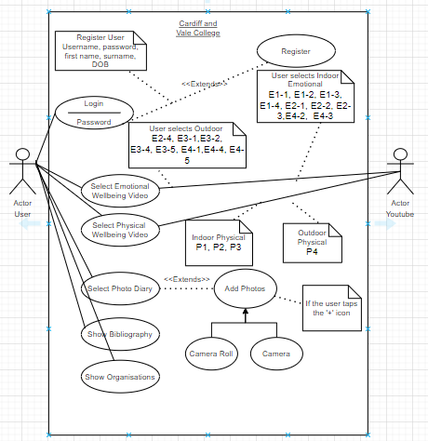
Use Case Amended

Slide 4
UML Case Description Amended
Use Case ID: | 1-V2
Use Case Name: | User selects Physical Wellbeing video
Actor: | User, YouTube
Description: | Allows user to select a Physical Wellbeing videos either from indoor or outdoor and is then displayed
Pre-Condition: | User has logged into the System User has chosen either indoor or outdoor videos
Post Condition: | User watches video and can select another option
Basic Flow: | The user opens the physical menu User selects video from menu User plays video
Exceptional Flow: | N/A
Alternative Flow: | User will not be able to access video

Slide 5
Use Case ID: | 2-V2
Use Case Name: | User selects Emotional Wellbeing video
Actor: | User, YouTube
Description: | Allows user to select a Emotional Wellbeing videos either from indoor or outdoor and is then displayed
Pre-Condition: | User has logged into the System User has chosen either indoor or outdoor videos
Post Condition: | User watches video and can select another option
Basic Flow: | The user opens the emotional menu User selects video from menu User plays video Video plays from YouTube
Exceptional Flow: | N/A
Alternative Flow: | User will not be able to access video

Slide 6
Use Case ID: | 3-V2
Use Case Name: | Photo Diary
Actor: | User
Description: | Allows user to take photo and add it to the camera roll or library.
Pre-Condition: | User can choose to add a photo into the camera roll
Post Condition: | User adds photo into camera roll
Basic Flow: | User takes photo with camera User can choose to add photo on camera roll User adds photo
Exceptional Flow: | N/A
Alternative Flow: | User does not add image to camera roll

Slide 7
Use Case ID: | 4-V2
Use Case Name: | More
Actor: | User
Description: | Allows user to access organisations and bibliography
Pre-Condition: | User can choose to go to the bibliography and organisations page.
Post Condition: | User goes on bibliography and organisations page
Basic Flow: | User goes on to the more menu User can choose either bibliography or organisations.
Exceptional Flow: | N/A
Alternative Flow: | User does no go on bibliography and organisations.

Slide 8
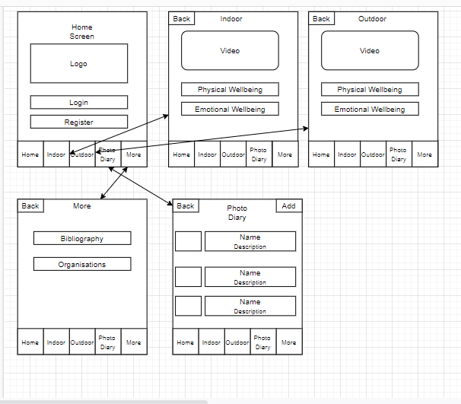
Storyboard Amended

Slide 9
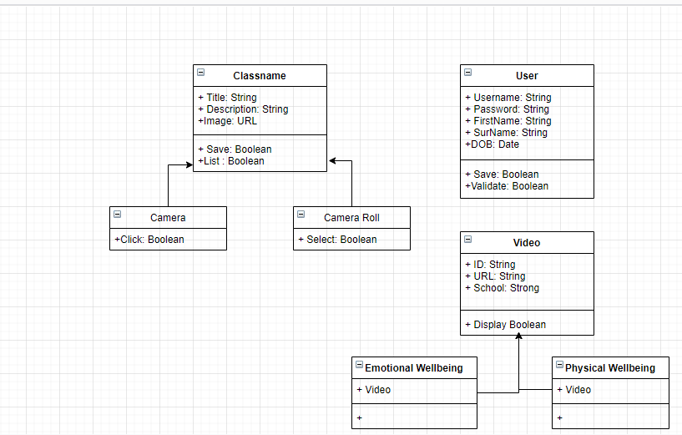
Use Class Amended

Slide 10
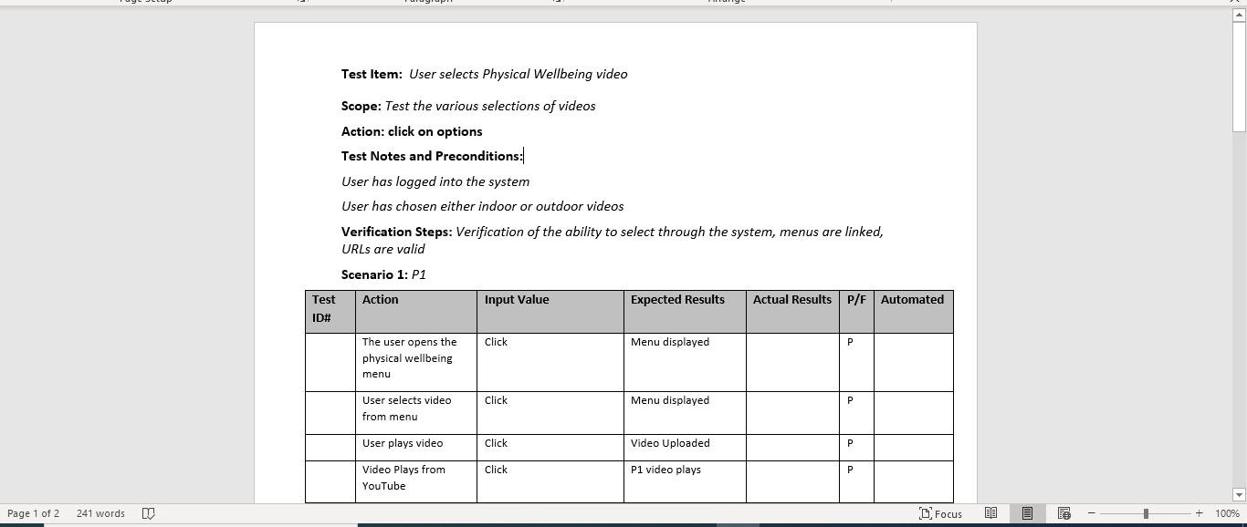
Test Log

Slide 11
